Slide 1






GIS AND TEMPERATURE TREND ANALYSIS
Study of temperature changes across Egypt's governorates
BY :G7

Slide 2




OUR VISION
Why should we study
Temperate changes
3. DATA COLLECTION
4. METHODOLOGY
5. RESULTS
AGENDA

Slide 3


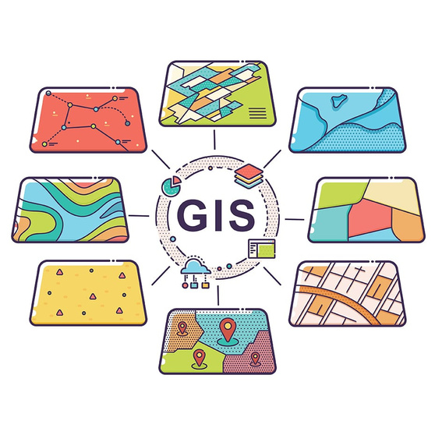




1- Our vision
THE STUDY FOCUSES ON ANALYZING CHANGES IN A KEY CLIMATE ELEMENT—TEMPERATURE—OVER THE PAST PERIOD UP TO THE PRESENT.
OBJECTIVE IS TO IDENTIFY THE PATTERN OF CHANGE, WHETHER AN INCREASE OR DECREASE

Slide 4

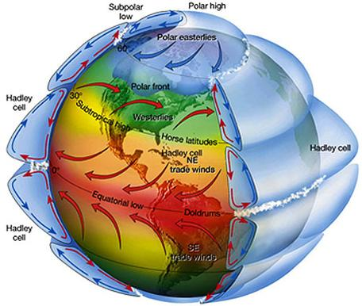
2-why should we study temperature change
Climate Monitoring and Environmental Planning
Impact on Atmospheric and Ocean Circulation Patterns
Effects on Biodiversity and Ecosystems

Slide 5



3-Data collection
The data collection phase is divided into..
meteorological stations
Temperature readings
"The locations of the climate monitoring stations were collected from the TuTiempo website."
National Aeronautics and Space Administration – Prediction Of Worldwide Energy Resources

Slide 6
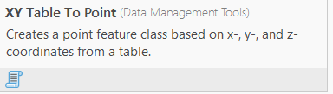
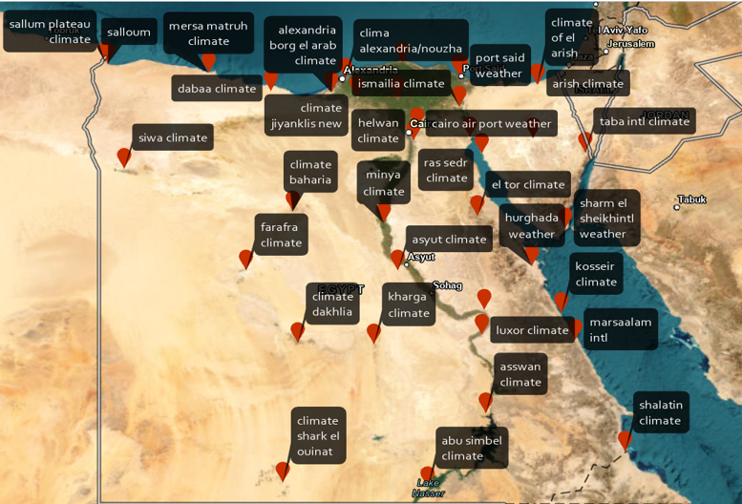
3-Data collection

Slide 7
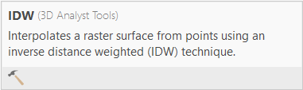
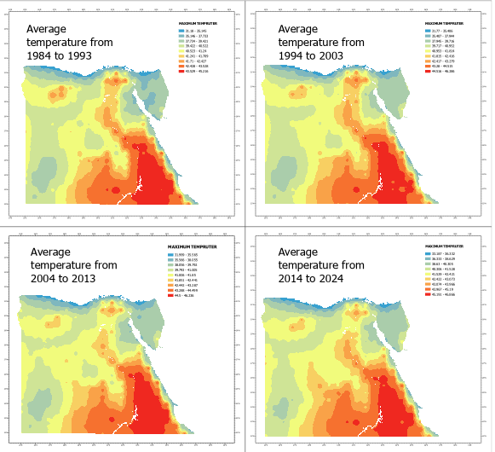
3-Data collection
3-Data collection
"By using the interpolation tool called IDW (Inverse Distance Weighting), I was able to generate a continuous surface representing the spatial distribution of temperature."

Slide 8
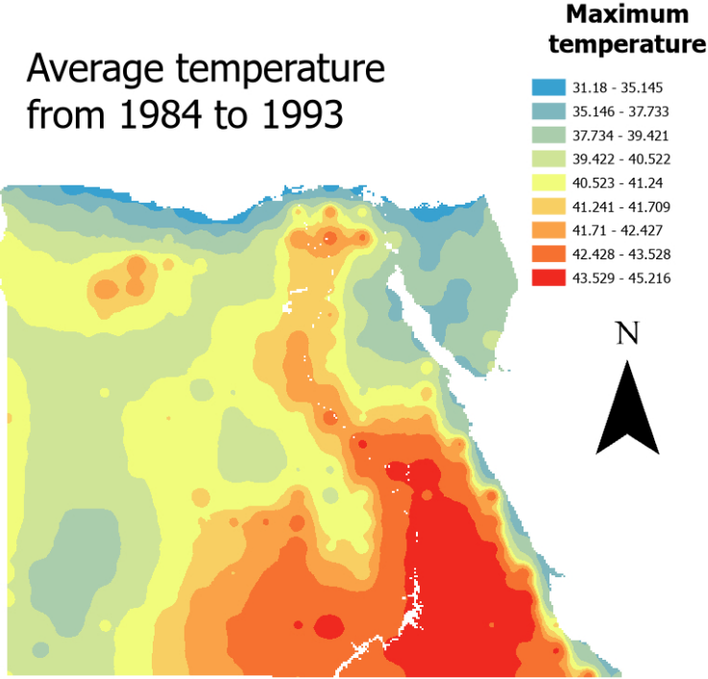

Slide 9
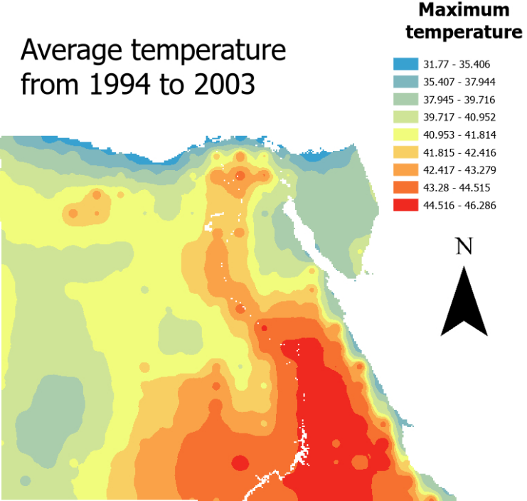

Slide 10
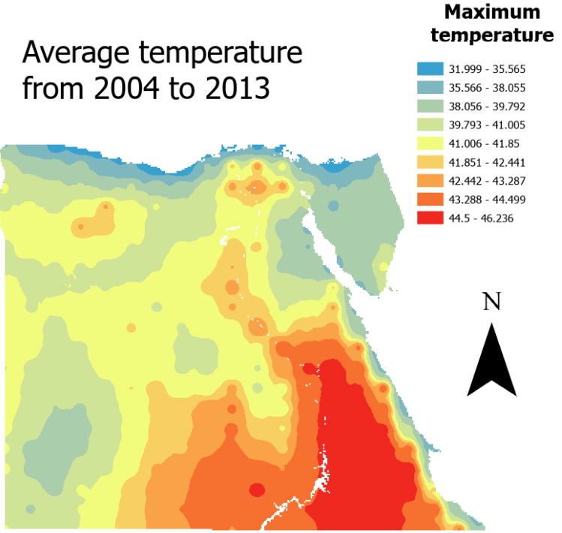

Slide 11
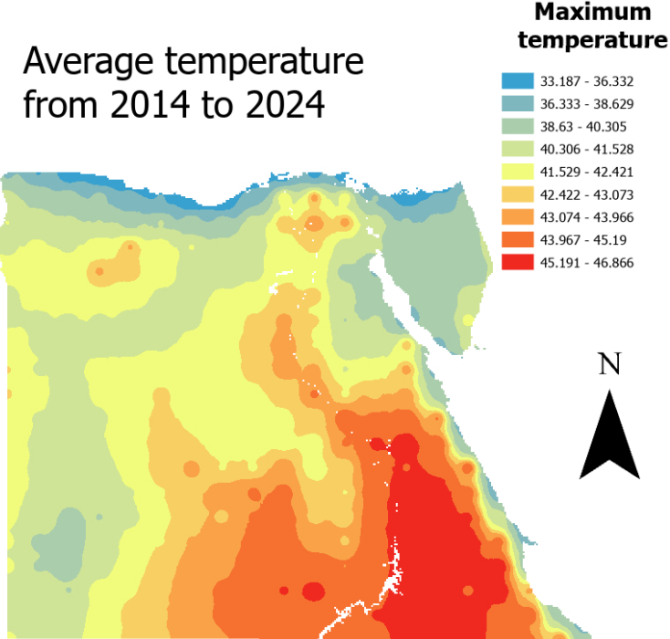

Slide 12


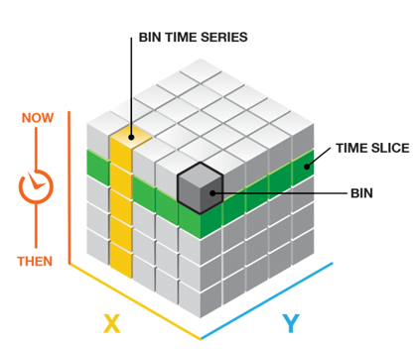
4- Methodology
Sen’s Slope Estimator
TREND ANALYSIS
Mann-Kendall Test
Space-time cube
P-value
Z-score

Slide 13
